Slide 1

1
Determination of Dynamic Tensile Strength of Concrete Using a Split Hopkinson Pressure Bar
Nik Benko, John Callaway, Nick Dorsett, Martin Raming
ME EN 6960
May 1, 2018
University of Utah
May 1, 2018

Slide 2
Description
2
Title
Slide numbers are to be placed in the top right corner.
Sign post to help you know where you are in the presentation
Text size
[1] Reference Text Size
Presentation Location
Date

Slide 3
Description
3
Notes on General Structure
1. There should be logical transitions between slides.
• If your presentation doesn’t flow that indicates that information is missing or out of order.
• Don’t memorize your slides, work to know the transitions and order of the slides. Public speaking should be done extemporaneously.
2. Present each slide in a logical manner, top down, left side right side.
• Don’t’ jump around
3. The general order of a presentation should be:
1. Title Slide (1)
2. Introduction (3-5)
3. Approach (2-3)
4. Results (3-5)
5. Conclusions (1-2)
6. Future Work (0-0.5)
7. References (as needed)
8. Acknowledgements (1)
Conference presentation
Any presentation
[1] Reference Text Size
Presentation Location
Date

Slide 4
Introduction
4
Notes on Introductions
1. Think about your audience. What are they likely to know about what you are presenting? What is their education level?
• This should dictate the level of background you give (3-5 slides).
2. Start at a fundamental level and build from there. As you build your presentation try to anticipate questions you might be asked.
• This should help dictate what background is necessary to cover.
3. In your introduction include the motivation for the project.
• Motivation should provide context of why the project is worth investigating. Write out the motivation for the project on your slides explicitly. This is one of the few things that I am okay with you reading word-for-word.
4. After your introduction it is okay to have a single slide that provides and overview to the rest of the presentation.
• I am not a fan of these unless they include pictures as well.
[1] Reference Text Size
Kingstedt Weekly Group Meeting
10/18/2017

Slide 5
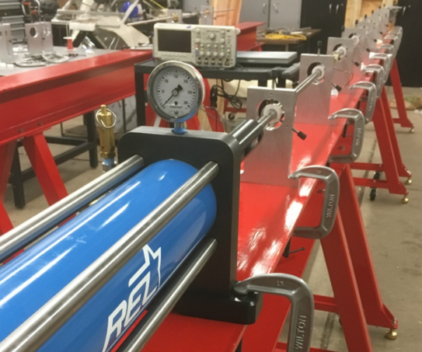



Approach: Experiments
5
Notes on Approach
1. When explaining your approach clearly layout what has been done.
2. Include a high quality picture of your experimental set-up and a schematic if necessary
triggering
$$V_{0}$$
$$ε_{I}\left(t\right) ,ε_{R}\left(t\right)$$
$$ε_{T}\left(t\right)$$
Long distance microscope lens
Signal Gen.
Flash lamps
Oscope
Shimadzu HPVX
[1] Reference Text Size
Kingstedt Weekly Group Meeting
10/18/2017

Slide 6
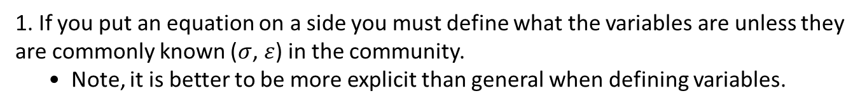
Approach: Equations
6
Notes on Approach
1. If you put an equation on a side you must define what the variables are unless they are commonly known ($σ$, $ε$) in the community.
• Note, it is better to be more explicit than general when defining variables.
$$s\left(x,y\right)= \frac{A}{2}\left(2+γ frng(2πfx+φ_{x}\left(x,y\right)+γ frng(2πfy+φ_{y}(x,y)))\right)$$
Image gray signature
2. References are key to the approach section. They help provide credence that the approach you are taking is generally accepted.
[1] Reference Text Size
Kingstedt Weekly Group Meeting
10/18/2017

Slide 7
Figures/Images
7
Notes on Figures/Images
1. Keep in mind that men are far more likely to be color blind. Avoid being completely dependent on color for presentations given to broad audiences. Avoid yellow, bright green, and cyan on plots. Use golden rod, forest green and blue.
2. If you can’t read the text on your computer screen from 6 ft away the text is too small.
• Size 10 is the absolute smallest your figure text should be.
3. If a data point is important to discuss add an arrow or call out to draw attention to it while specifying its importance.
4. Make all plots using MATLAB using Helvetica Font (sans serif)
• https://blogs.mathworks.com/loren/2007/12/11/making-pretty-graphs/
5. Use the digitize plot function if you need to take data from published work.
• http://www.mathworks.com/matlabcentral/fileexchange/928-digitize2-m
6. Adapting figures from textbooks, publications, the web, etc. is okay. When recreating art make sure you give credit to the source.
[1] Reference Text Size
Presentation Location
Date

Slide 8
Results
8
Notes on Results
1. Results are the outcomes of your approach.
• It should be clear how you obtained a specific result. If you can’t clearly explain where it came from, you are missing something in your approach section.
2. Many times results obtained are image or video based.
• Take time to make sure they are easy to understand.
• If playing a video make sure to describe it in advance, play it, play it again highlighting important features.
• Include scale bars.
3. Results are something that you have to interpret.
• When presenting your interpretation it should be clear and authoritative.
4. These are what people come to see. Make it worth their time.
[1] Reference Text Size
Presentation Location
Date

Slide 9
Conclusions
9
Notes on Conclusions
1. Conclusions are not observations.
2. Use a bulleted list with pictures to hit the important points.
3. For a presentation you should end up with anywhere from one to five conclusions.
Notes on Future Work
1. Do not include future work in a conference presentation unless you have already started it.
2. Future work can detract from what you have done. Be careful not to shift the focus of the work done to a new area.
[1] Reference Text Size
Presentation Location
Date

Slide 10
Conclusions
10
Notes on References
1. Provide enough information so people can actually find the source cited.
2. Feel free to use slightly smaller font to fit references to a single page.
Notes on Acknowledgements
1. Don’t forget to acknowledge those that have actually helped you conduct the work.
• Concise list, not a free for all
• Acknowledge the funding agency when applicable.
• Multi user facilities tend require you to put some sort of acknowledgement on all papers and presentations. Be sure to include them.
[1] Reference Text Size
Presentation Location
Date

